Slide 1
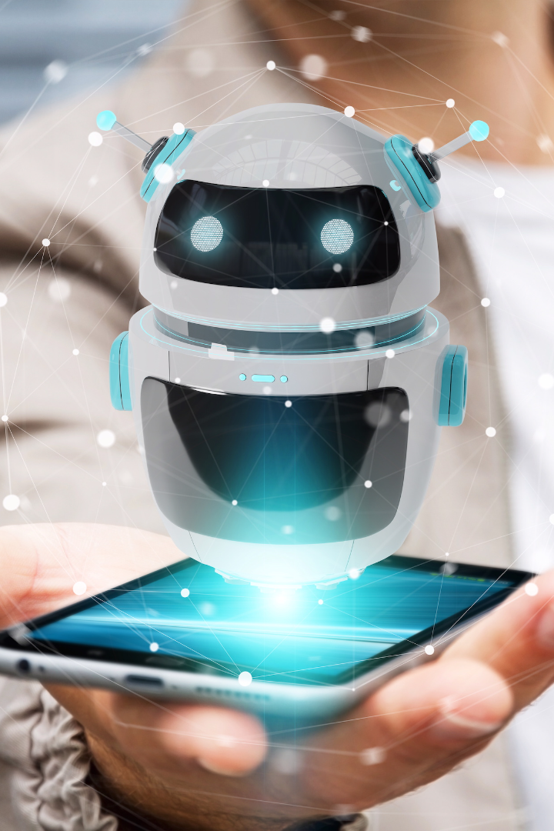
Chatbot Development with IBM Cloud Watson Assistant

Slide 2
The Power of IBM Cloud Watson Assistant
Intuitive UX
Scalable Infrastructure
Watson Assistant's natural language processing enables chatbots to understand user intent and reply accordingly.
Watson Assistant is designed to scale with your business, enabling you to support increasing numbers of customers and conversations.
Seamless Integration
Customizable Solutions
Watson Assistant can be integrated with a wide range of platforms, including Slack, Facebook Messenger, and more.
Watson Assistant's flexible architecture enables you to customize your chatbot to meet your unique needs.

Slide 3
Identifying Chatbot Issues
1
Lack of Personalization
Chatbots that fail to recognize users and deliver personalized experiences can leave customers feeling frustrated or ignored.
Confusing Conversations
2
Chatbots that struggle to understand user intent or deliver inconsistent responses can lead to confusion and frustration.
3
Limited Functionality
Chatbots with limited functionality or restricted access can be less effective at meeting customer needs and solving complex problems.

Slide 4

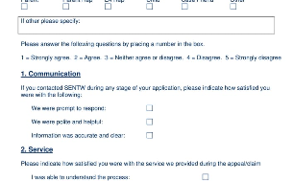
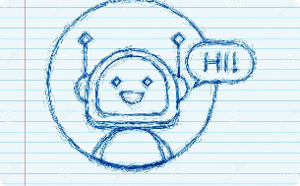
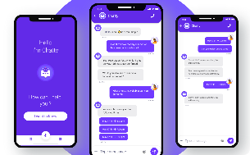
Designing a Chatbot Solution
Brainstorming
Customer Feedback
Design Sketch
Start your chatbot project by brainstorming what you want your chatbot to do and how it will improve the customer experience.
Use customer feedback to better understand user needs and design a personalized chatbot experience.
Create a design sketch to map out the user journey and ensure that the chatbot flow is intuitive and easy to follow.
Mockup Design
Create a mockup design to test the chatbot's functionality and ensure that the user experience is optimized.

Slide 5
Transformation Phase
Implementation
Testing & Optimization
Integration
Implement your design by building and deploying your chatbot solution using IBM Cloud Watson Assistant.
Integrate your chatbot with external systems, such as customer management or sales tools, to improve efficiency and customer satisfaction.
Test your chatbot's functionality and optimize the user experience to ensure a positive customer experience.

Slide 6

Using IBM Cloud Watson Assistant
1
Creating Intents
Create intents that reflect the goals and objectives of the chatbot, and map out sample dialogs to provide specific examples of user interactions.
Defining Entities
2
Define entities that represent key concepts in the chatbot's domain, such as product names, dates, or locations.
3
Configuring Dialogs
Configure dialogs that map user inputs to intents and entities, enabling the chatbot to respond appropriately to user requests.

Slide 7
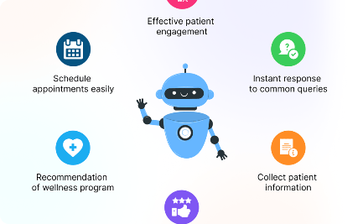
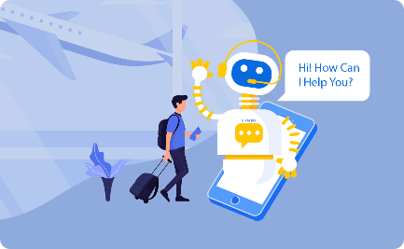
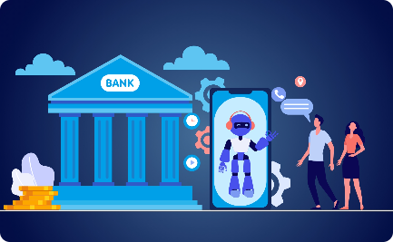
Successful Chatbot Examples
Healthcare Chatbot
Travel Chatbot
Banking Chatbot
IBM Watson Assistant was used to develop a chatbot to help patients book appointments and provide medical advice.
IBM Watson Assistant was used to develop a chatbot to help customers book and manage travel itineraries.
IBM Watson Assistant was used to develop a chatbot to handle customer service requests for a banking institution.

Slide 8

Conclusion
1
Enhanced Customer Experience
2
Improved Efficiency & Scalability
IBM Cloud Watson Assistant enables businesses to create customized, personalized chatbot solutions that improve the customer experience.
Using IBM Cloud Watson Assistant to develop chatbot solutions can improve business efficiency and scalability.
3
Cost-Effective Solution
Developing chatbots with IBM Watson Assistant can be a cost-effective solution for businesses looking to improve customer interactions.

